Slide 1

Module 6 - Business process management notation (BPMN)
Dr. Tuan Truong

Slide 2
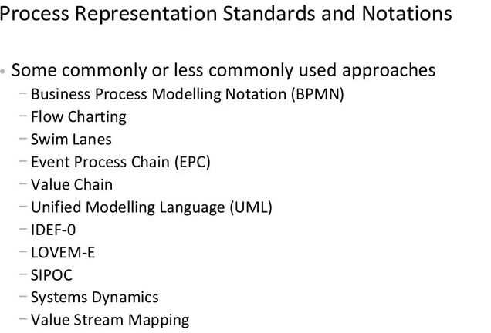
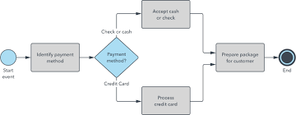
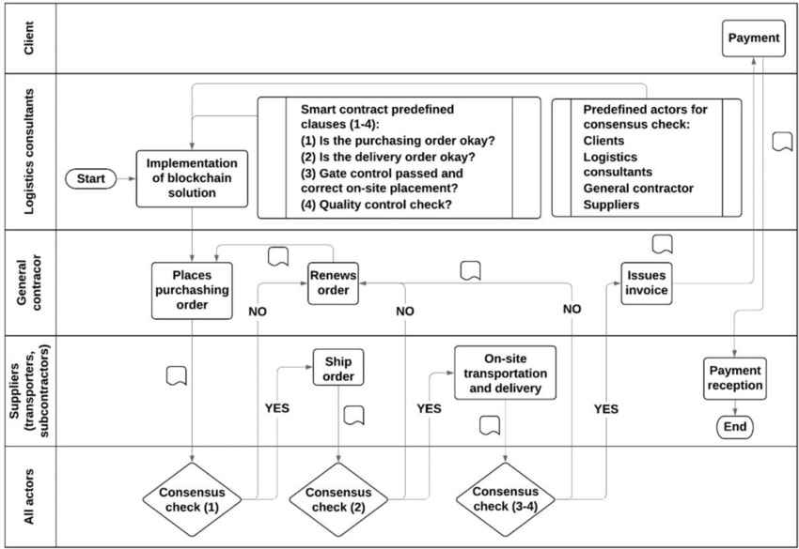
Process analysis and design
business process modeling notation
Swim Lanes
Other tools in Business Process Analysis and Design Handout

Slide 3
BPMN from 10,000 miles…
Based on popular graphical flowcharts:
Core set of notation elements
Each core element has various subtypes
A BPMN process model is a graph consisting of four types of core elements:
start
end
activity
event
gateway
sequence flow

Slide 4
Let’s start modeling
Order-to-cash process
A typical order-to-cash process is triggered by the receipt of a purchase order from a customer. The purchase order has to be checked against the stock regarding the availability of the item(s) requested. Depending on stock availability the purchase order may be confirmed or rejected.
If the purchase order is confirmed, an invoice is emitted and the goods requested are shipped. The process completes by archiving the order or if the order is rejected.

Slide 5
Solution in BPMN: Order-to-cash
end event
activity
split gateway
end event
start event
Naming conventions
Event: noun + past-participle verb (e.g. insurance claim lodged)
Activity: imperative verb + noun (e.g. assess credit risk)

Slide 6
BPMN core elements
Activities capture work performed in a process
Different types of activities
Events represent the process’ triggers (start event) and outcomes (end event).
Different types of events
activity
start
event
end
event

Slide 7
BPMN core elements
Gateways capture forking and joining paths in the control flow.
Different types of gateways
Sequence flows represent the order in which activities and events will be performed.
They can be assigned a condition to distinguish between alternative branches.
Different types of flows
gateway
sequence flow

Slide 8
Process model vs process instances: The tokens game
Order #1
Order #2
Order #3

Slide 9
A little bit more on events…
A start event triggers a new process instance by generating a token that traverses the sequence flow (“tokens source”)
An end event signals that a process instance has
completed with a given outcome by consuming
a token (“tokens sink”)
start
event
end
event

Slide 10
Let’s reconsider our order-to-cash example
[…] If the purchase order is confirmed, an invoice is emitted and the goods requested are shipped. The process completes by archiving the order. […]

Slide 11

Solution: Order-to-cash
Anything wrong with this model?
split
split
join

Slide 12
A little more on gateways: XOR Gateway
An XOR Gateway captures decision points (XOR-split) and points where alternative flows are merged (XOR-join)
XOR-split ➔ takes one outgoing branch
XOR-join ➔ proceeds when one incoming branch has completed

Slide 13
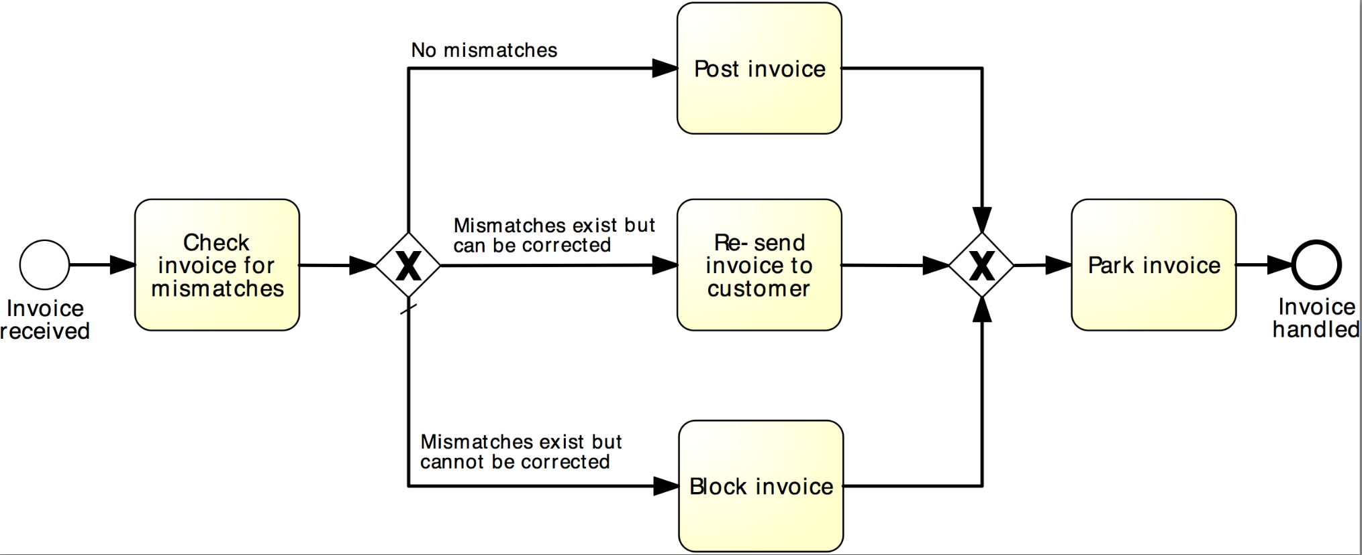
Example: XOR Gateway
Invoice checking process

Slide 14
Exercise 6.1
Model the following fragment of a business process for assessing loan applications (loan origination process).
Once a loan application has been approved by the loan provider, an acceptance pack is prepared and sent to the customer. The acceptance pack includes a repayment schedule which the customer needs to agree upon by sending the signed documents back to the loan provider. The latter then verifies the repayment agreement: if the applicant disagreed with the repayment schedule, the loan provider cancels the application; if the applicant agreed, the loan provider approves the application. In either case, the process completes with the loan provider notifying the applicant of the application status.

Slide 15
A little more on gateways: AND Gateway
An AND Gateway provides a mechanism to create and synchronize “parallel” flows.
AND-split ➔ takes all outgoing branches
AND-join ➔ proceeds when all incoming branches have completed

Slide 16
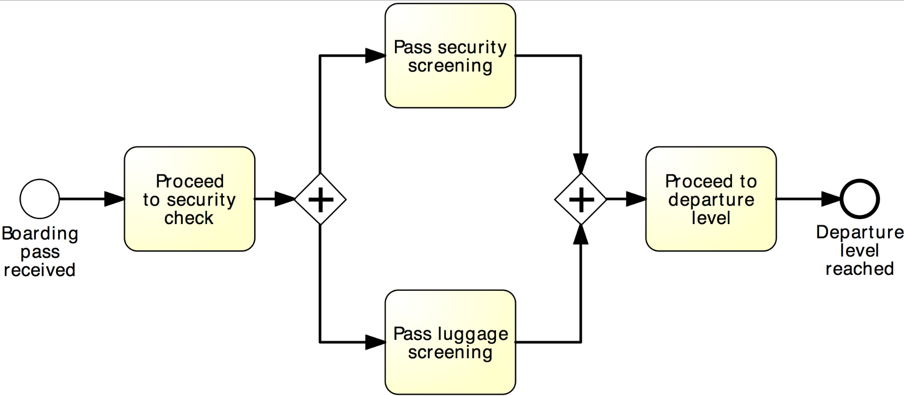
Example: AND Gateway
Airport security check

Slide 17
Revised solution
Order-to-cash
XOR-split
AND-split
AND-join

Slide 18
Exercise 6.2
Model the following fragment of a business process for assessing loan applications.
A loan application is approved if it passes two checks: i) the applicant’s loan risk assessment, done automatically by a system, and ii) the appraisal of the property for which the loan has been asked, carried out by a property appraiser. The risk assessment requires a credit history check on the applicant, which is performed by a financial officer. Once both the loan risk assessment and the property appraisal have been performed, a loan officer can assess the applicant’s eligibility. If the applicant is not eligible, the application is rejected, otherwise the acceptance pack is prepared and sent to the applicant.

Slide 19
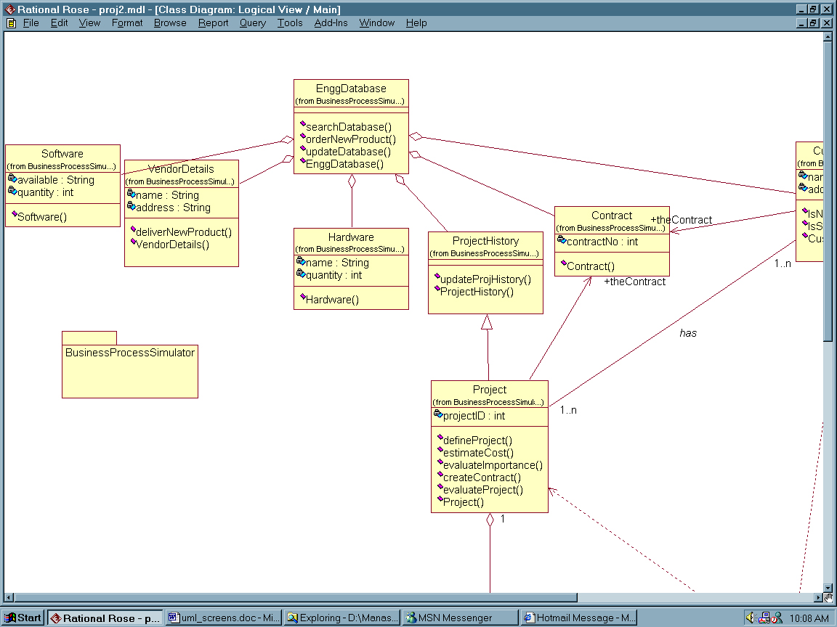
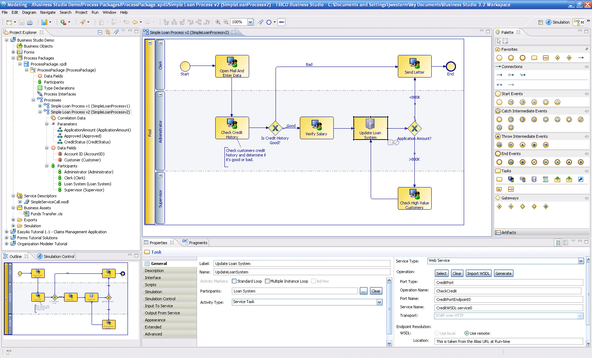
Business Process Modeling Tools
Pen & Paper
Haptic
Standalone
E.g. Visio, Camunda Modeler
Repository-based
E.g. ARIS, Signavio, Apromore

Slide 20
XOR / AND are not always what we need...
Order distribution process
A company has two warehouses, one in Amsterdam, the other in Hamburg, that store different products. When an order is received, it is distributed across these warehouses: if some of the relevant products are maintained in Amsterdam, a sub-order is sent there; likewise, if some relevant products are maintained in Hamburg, a sub-order is sent there. Afterwards, the order is registered and the process completes.

Slide 21
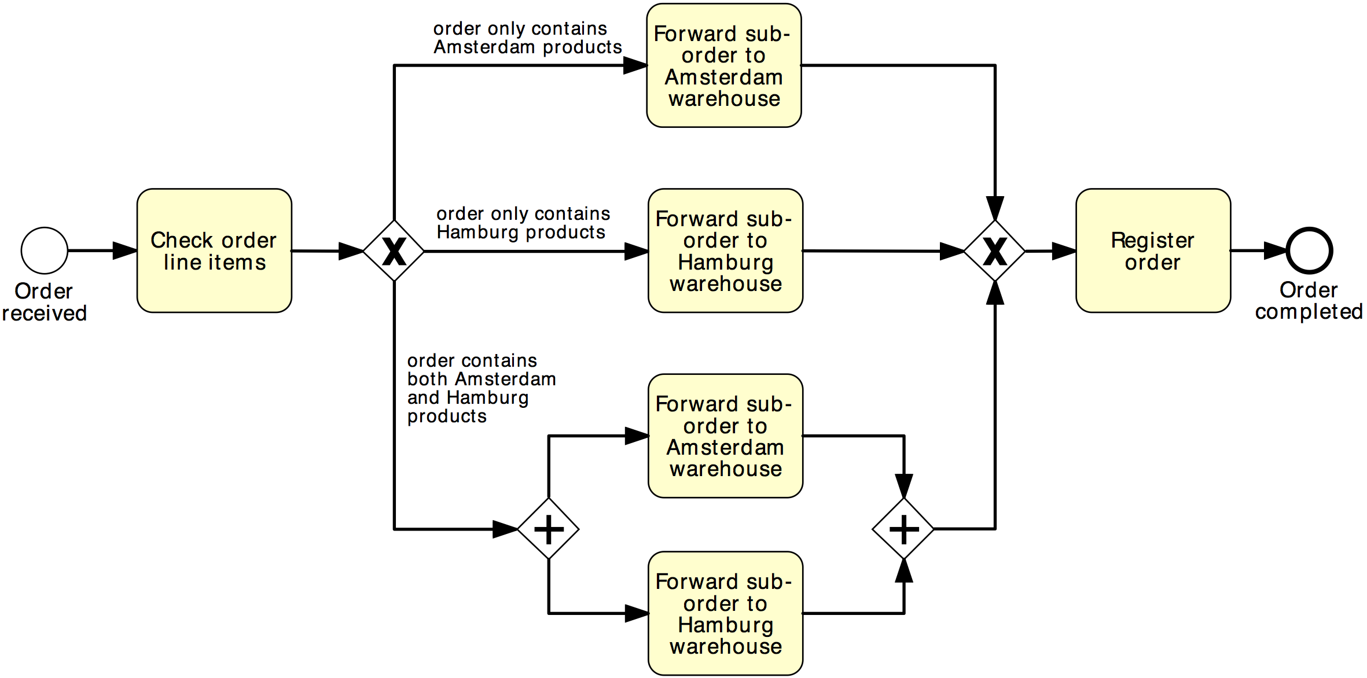
Solution 1
Order distribution process
XOR-split
XOR-join
AND-split
AND-join

Slide 22
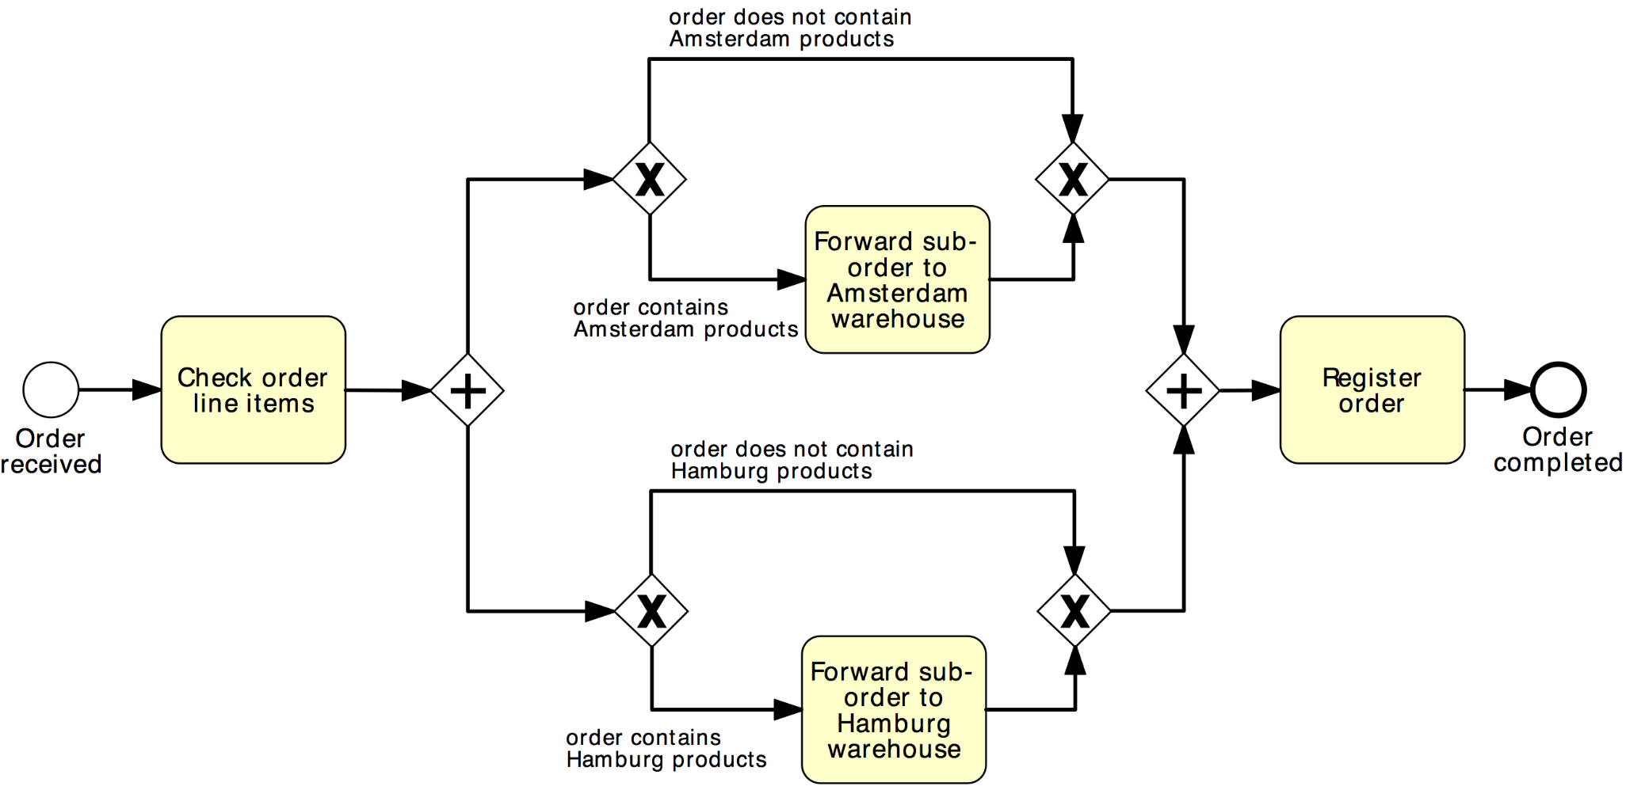
Solution 2
Order distribution process
AND-split
AND-join
XOR-split
XOR-join

Slide 23
OR Gateway
An OR Gateway provides a mechanism to create and synchronize n out of m parallel flows.
OR-split ➔ takes one or more branches depending on conditions
OR-join ➔ proceeds when all active incoming branches have completed

Slide 24
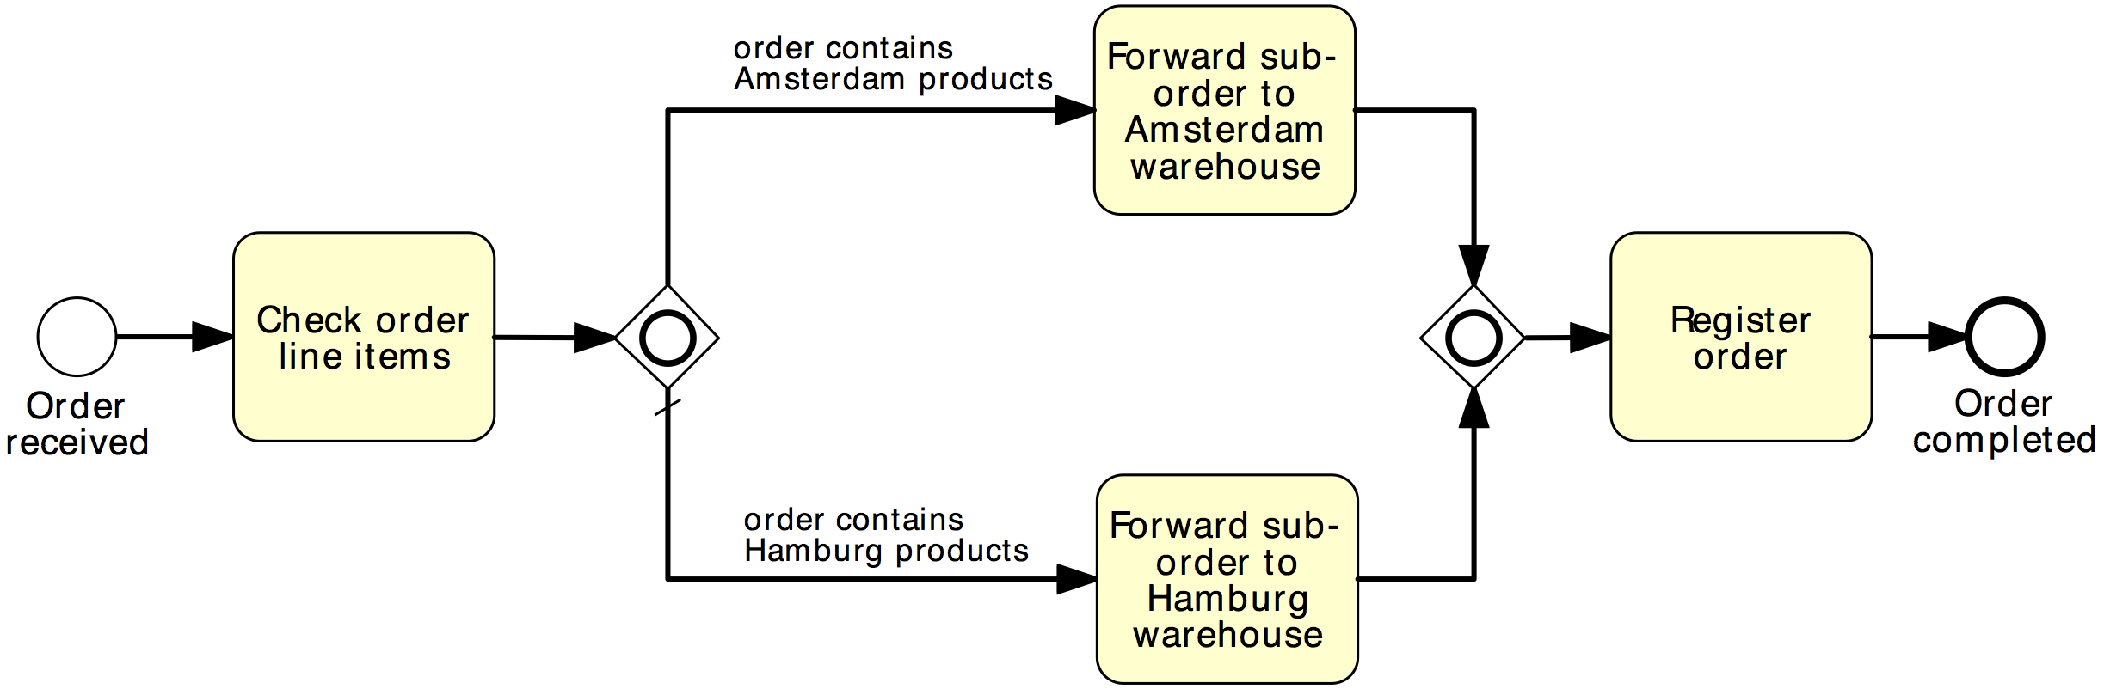
Solution using OR Gateway
Order distribution process
OR-split
OR-join

Slide 25
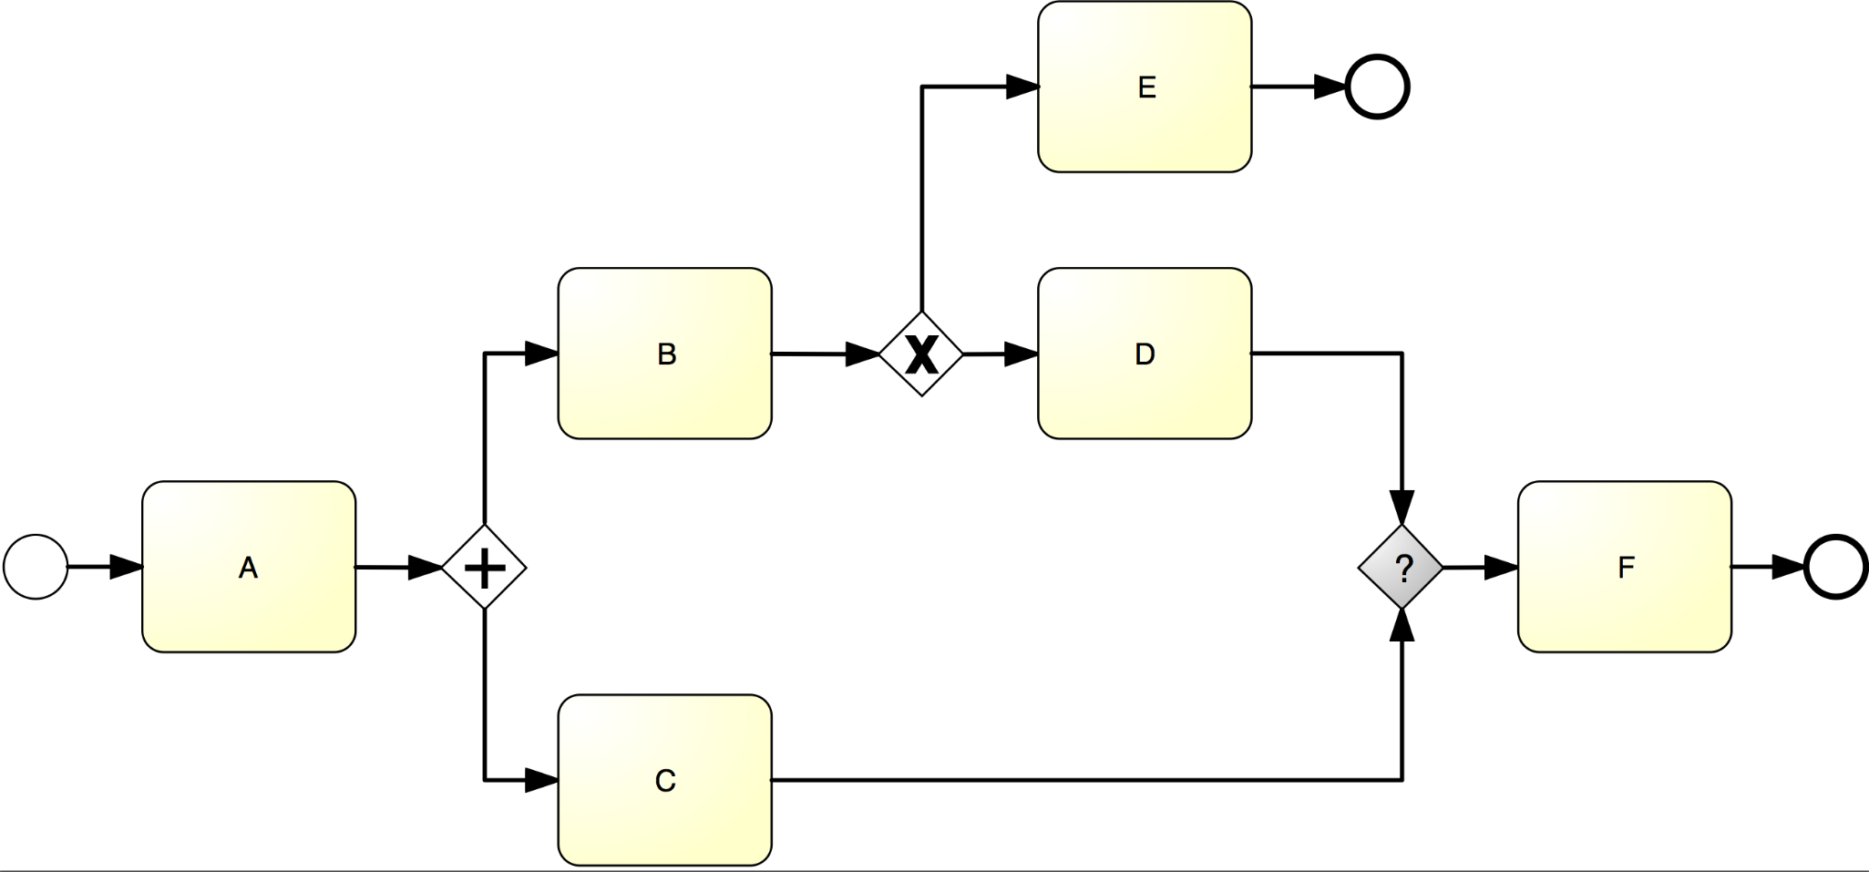
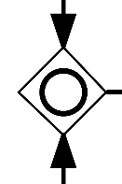
What join type do we need here?

Slide 26




Business Objects (aka artifacts)
Can be:
Physical or digital information artifacts (e.g. an order on paper, an invoice on PDF)
Physical material (e.g. a box containing the ordered goods)

Slide 27
Our Order-to-cash process, again
The purchase order document serves as an input to the stock availability check against the Warehouse DB. Based on the outcome of this check, the status of the document is updated, either to “approved” or “rejected”. If the order is approved, an invoice and a shipment notice are produced. The order is then archived on the Orders DB.

Slide 28
Business Objects in BPMN
A Data Object captures an artifact required (input) or produced (output) by an activity.
Can be physical or electronic
A Data Store is a place containing data objects that must be persisted beyond the duration of a process instance.
It is used by an activity to store (as output) or retrieve (as input) data objects.

Slide 29
Solution
The purchase order document serves as an input to the stock availability check against the Warehouse DB. Based on the outcome of this check, the status of the document is updated, either to “approved” or “rejected”. If the order is approved, an invoice and a shipment notice are produced. The order is then archived on the Orders DB.

Slide 30
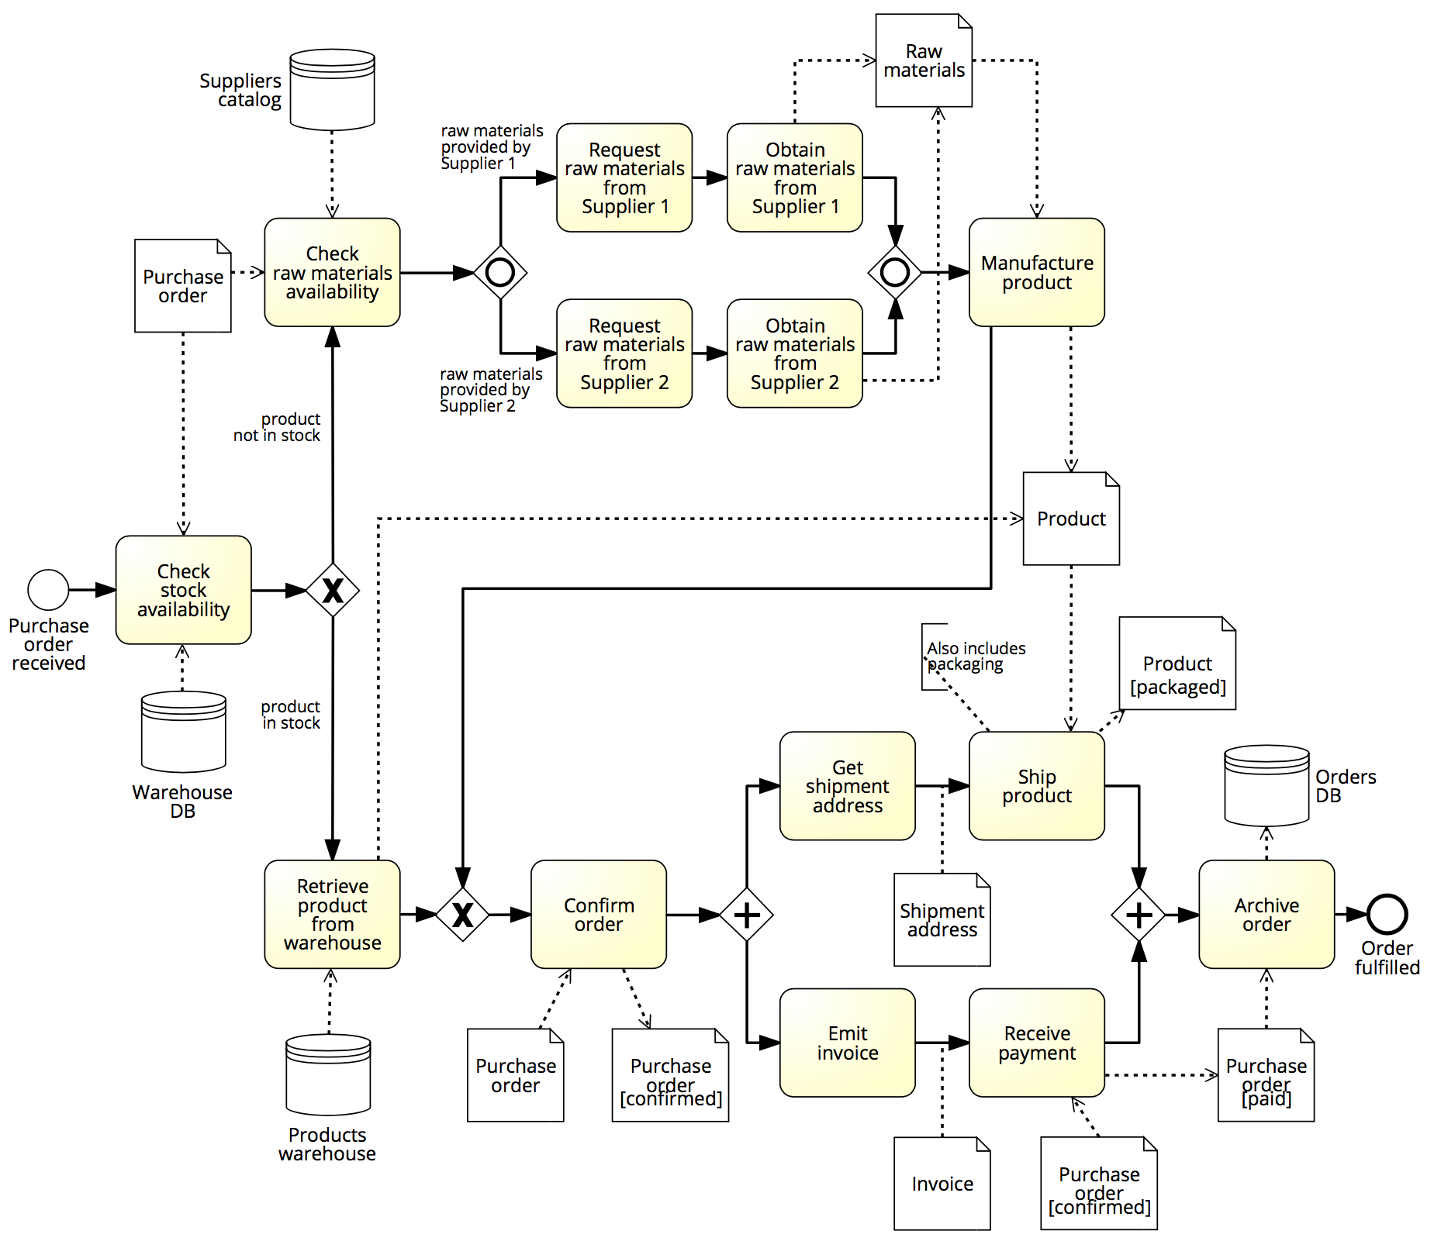
Exercise 6.3
Is there any missing data object or data store in the example below?

Slide 31




Process Resources

Slide 32

PROCESS Resources
Active resources:
Process participant
Software system
Equipment
Resource class:
A group of (active) resources that are interchangeable, e.g. a role, an organizational unit or the whole organization.

Slide 33
BPMN Elements – Pools & Lanes
Pool
Captures a resource class. Generally used to model a business party (e.g. a whole company)
Lane
Captures a resource sub-class within a resource class by partitioning a pool. Generally used to model departments (e.g. shipping, finance), internal roles (e.g. Manager, Associate), software systems (e.g. DBMS, CRM) or equipment (e.g. Manufacturing plant)

Slide 34


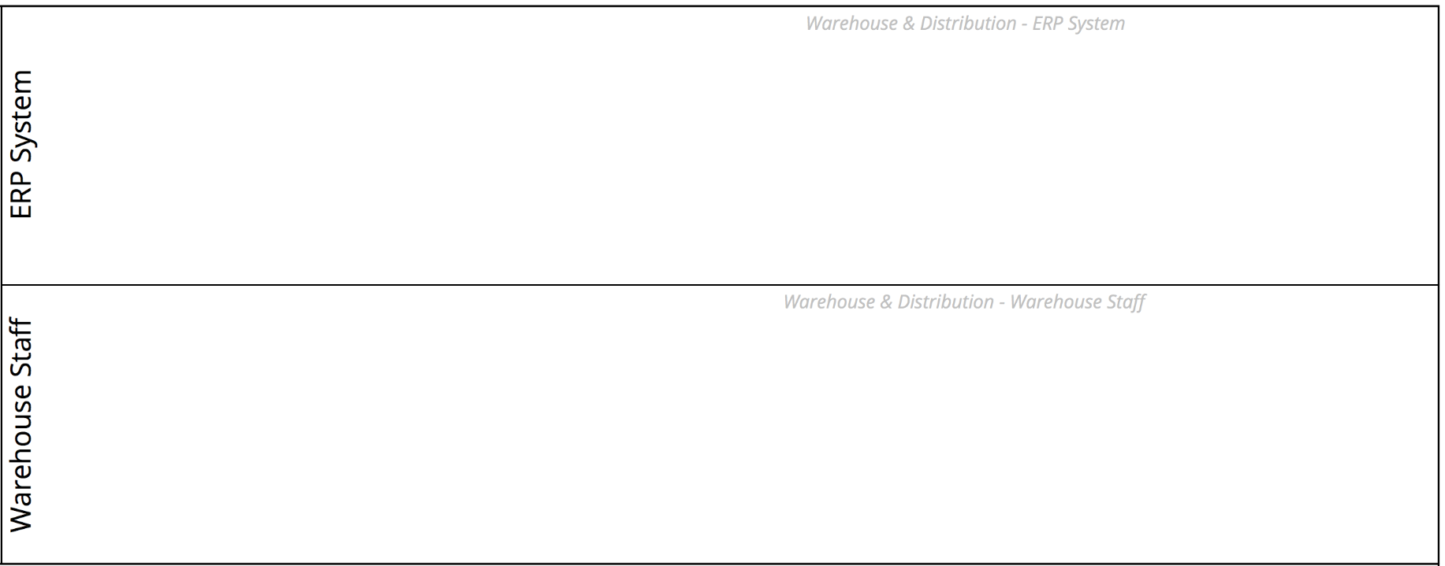
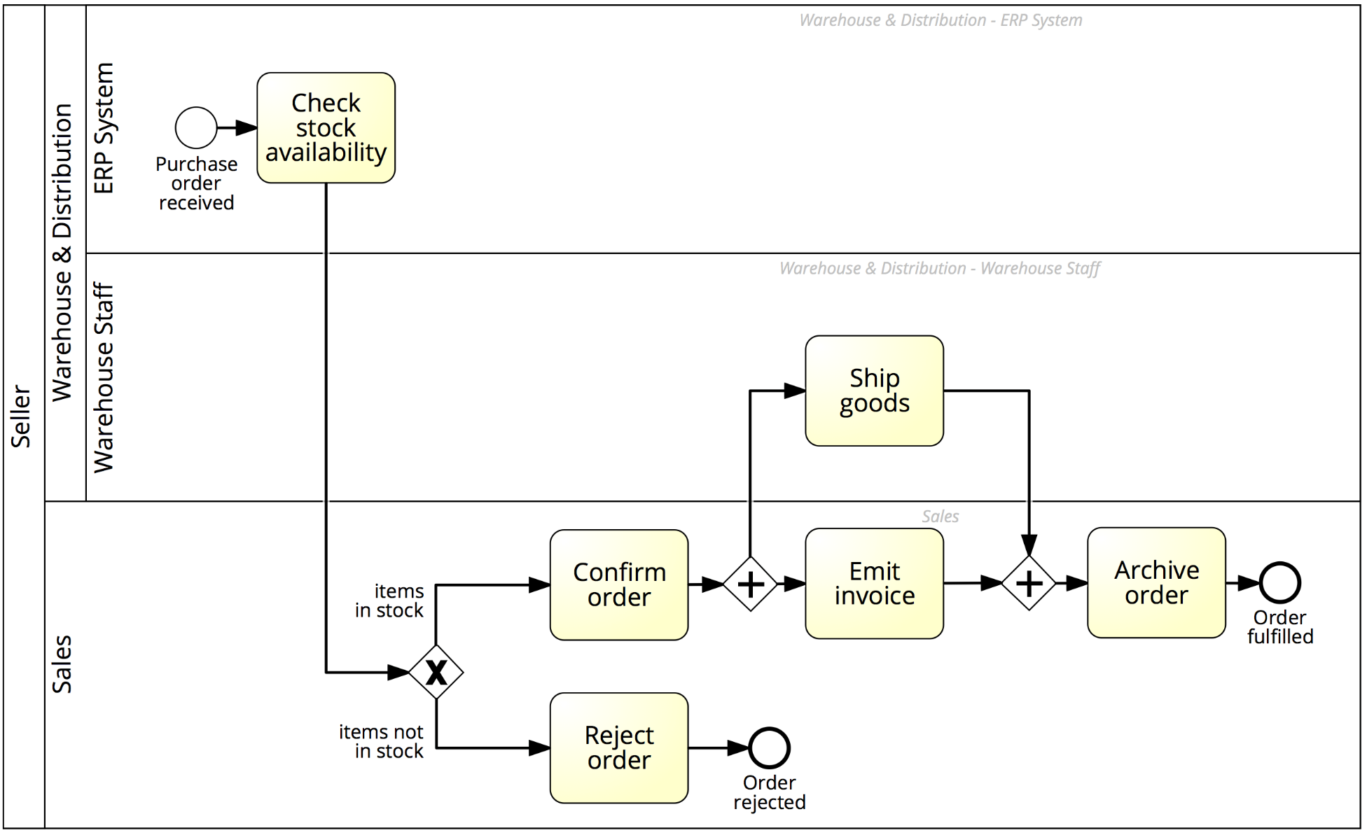
Example: Order-to-cash

Slide 35
BPMN Elements – Message Flow
A Message Flow represents a flow of information or materials between two process parties (Pools)
A Message Flow can connect:
directly to the boundary of a Pool ➔ captures a message to/from that party
to a specific activity or event within that Pool ➔ captures a message that triggers a specific activity/event within that party

Slide 36
BPMN Elements – Start Message Event
The start message event triggers a process by the receipt of a message when an incoming message flow is connected to the event

Slide 37
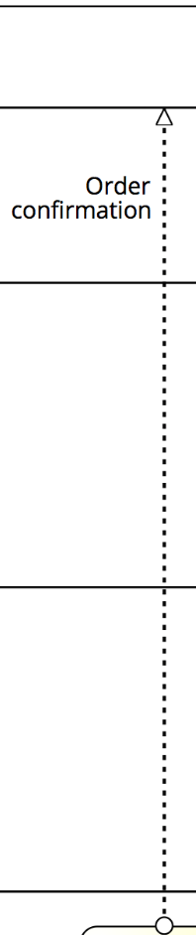


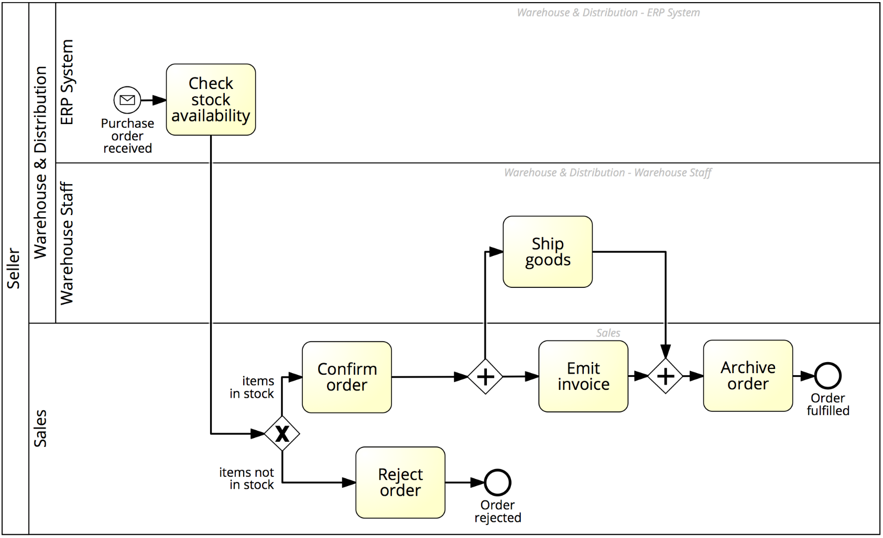
example: Order-to-cash

Slide 38
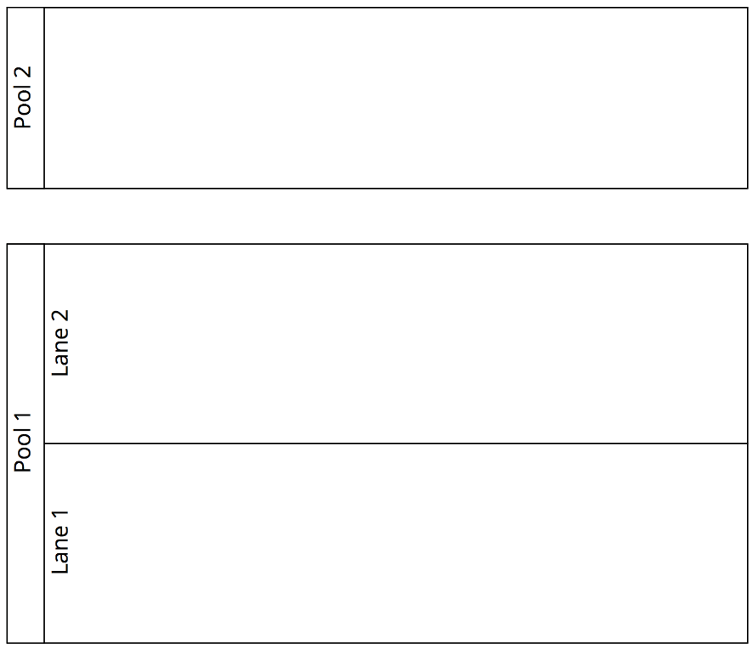

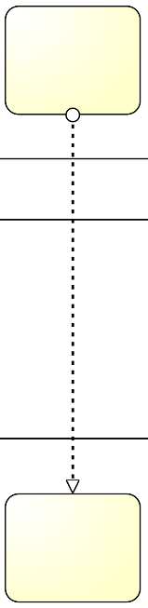
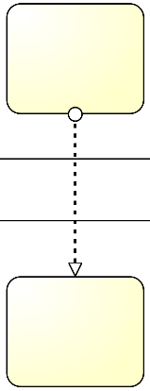


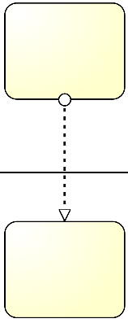
Pools, Lanes and Message Flows: syntax
The Sequence Flow cannot cross the boundaries of a Pool
Both Sequence Flow and Message Flow can cross the boundaries of Lanes
A Message Flow cannot connect two flow elements within the same pool

Slide 39
When are messages sent or received?
A Send activity will send the outgoing message upon activity completion
A Receive activity won’t start until the incoming message has been received
Note: the order of the message flows w.r.t. an activity is irrelevant, the above rules always hold

Slide 40
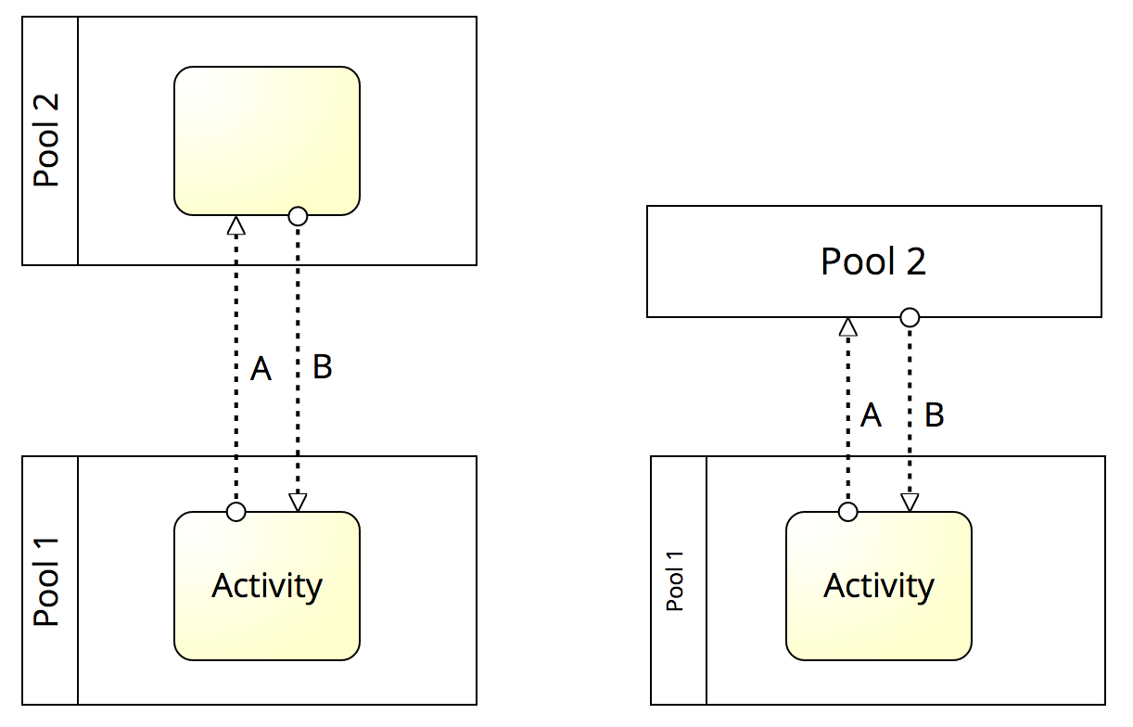
When are messages sent or received?
Message B is first received before Activity can start.
Message A is sent after, upon Activity’s completion
First, message B is received, before Activity can start.
Then, message A is sent, upon Activity’s completion

Slide 41
Process (or Orchestration) Diagram
Models a single business party and can be:
Public view (black box)
Private view (white box)

Slide 42
Collaboration Diagram
Private process
Public process
Models a global business process between at least two business parties (each modelled by a Pool)

Slide 43
Bpmn tool
https://demo.bpmn.io/
https://www.bpsimulator.com/run/

Slide 44
Question and answer

